Slide 1

Invoke-NoShell
Bsides<3TLV
June 2018

Slide 2
Outline
PoWERSH^eLL
Why do we use it?
Where red teamers lack tools?
Invoke-NoShell: all the power, no shell
Test-drive results

Slide 3

FAST TALK!

Slide 4




Background
Previous work
NeedLess
LazyS
SmoothCriminal
Special thanks
@Gal_B1t
https://github.com/G4LB1T
Notes:
Thanks to Phillip, Dana and Daniel Bohannon

Slide 5
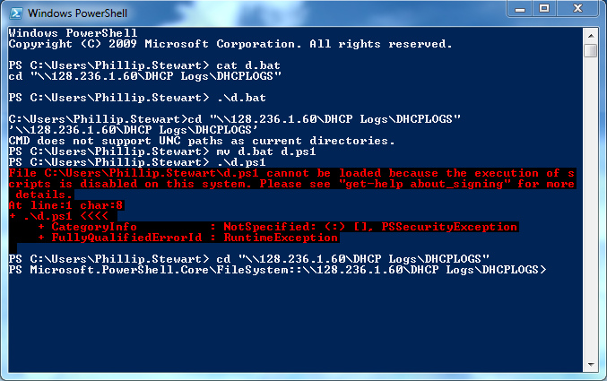
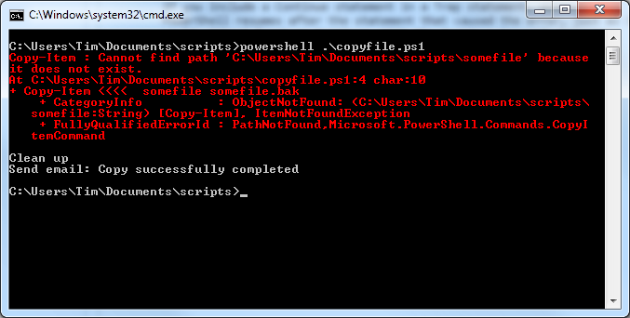
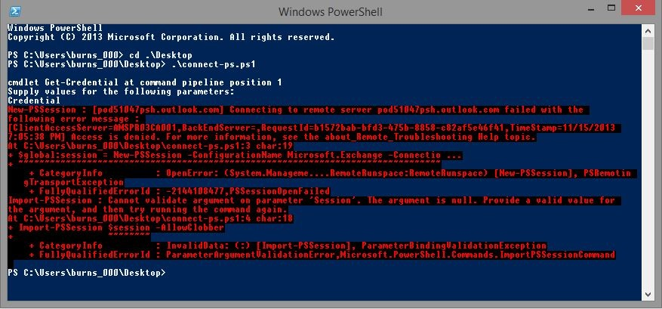
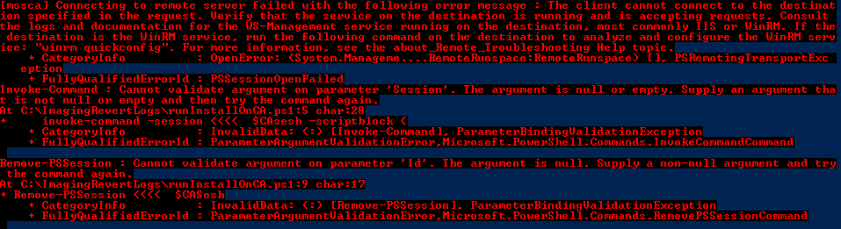
Mast^ERINg PowerSHell $for fUn -and PrOFIt

Slide 6
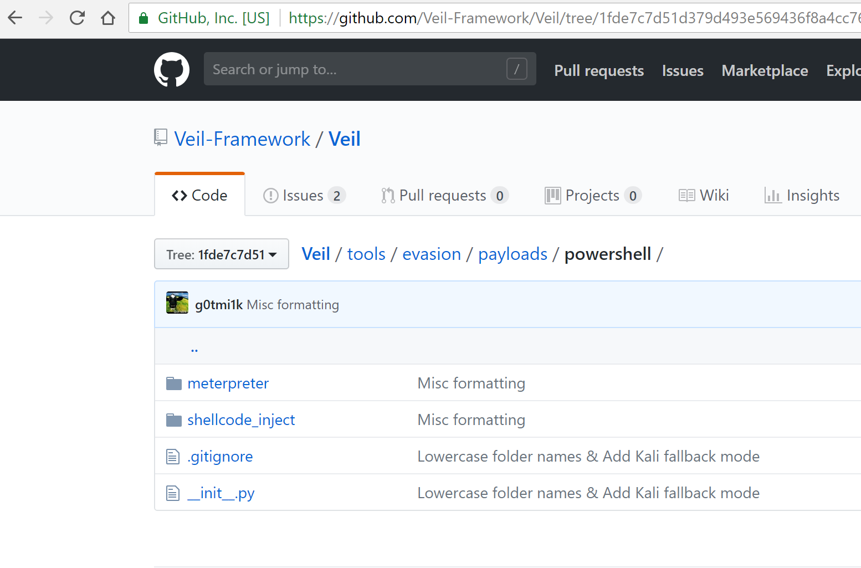

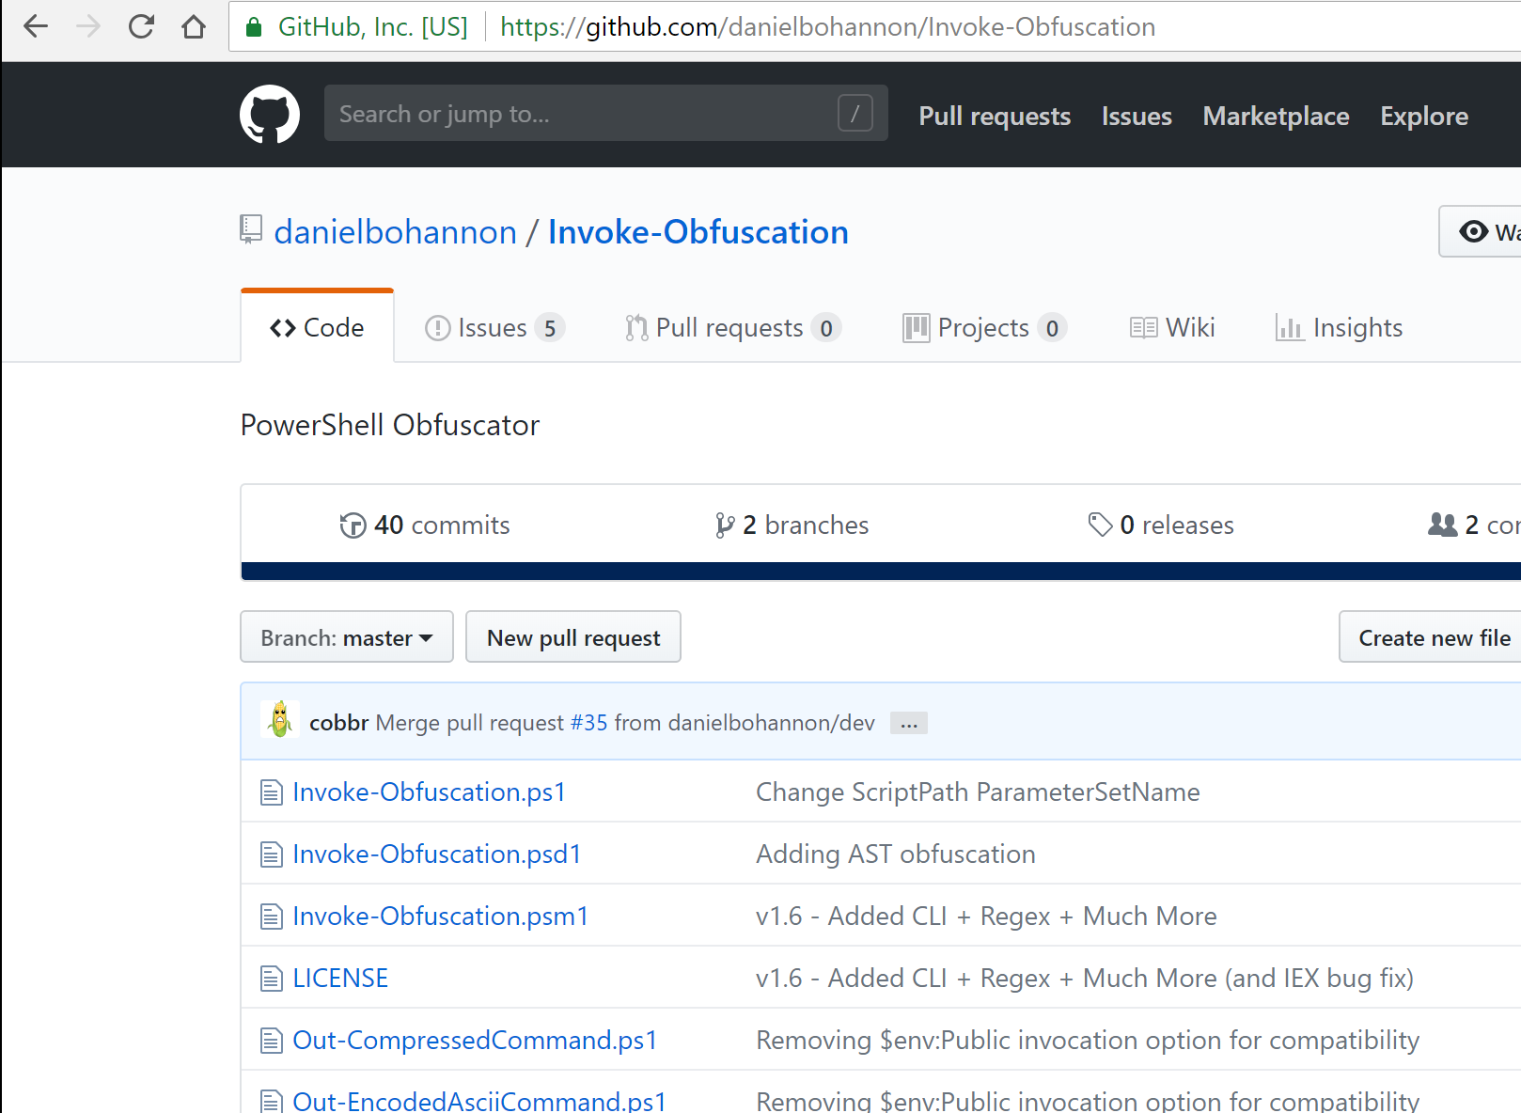
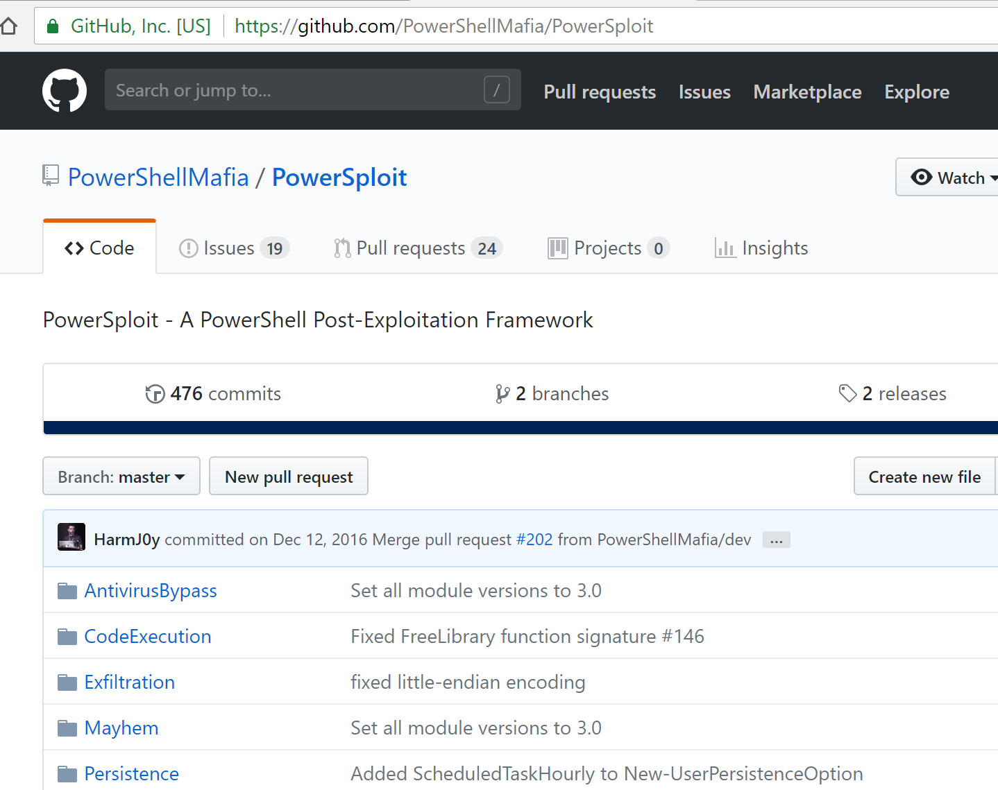
Why PowerShell?
Easy
Existing work
Mafia
Invoke-Obfuscation
~Veil, Metasploit
Gazilion other ones…
Notes:
We have PowerShell Mafia by Will AKA Harmj0y, Invoke Obfuscation by Daniel Bohannon and Veil by Chris Truncer

Slide 7
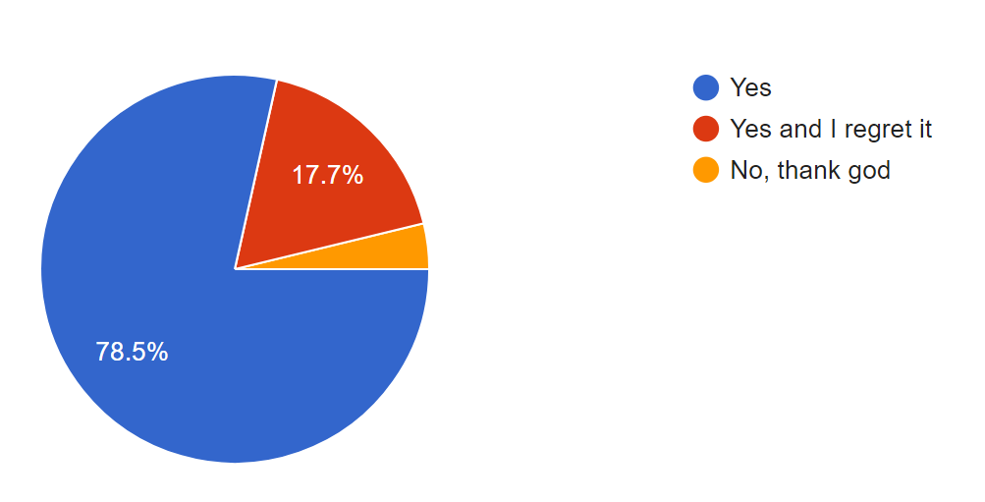
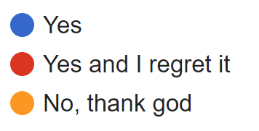
Have you ever used PowerShell?
That’s me :(

Slide 8
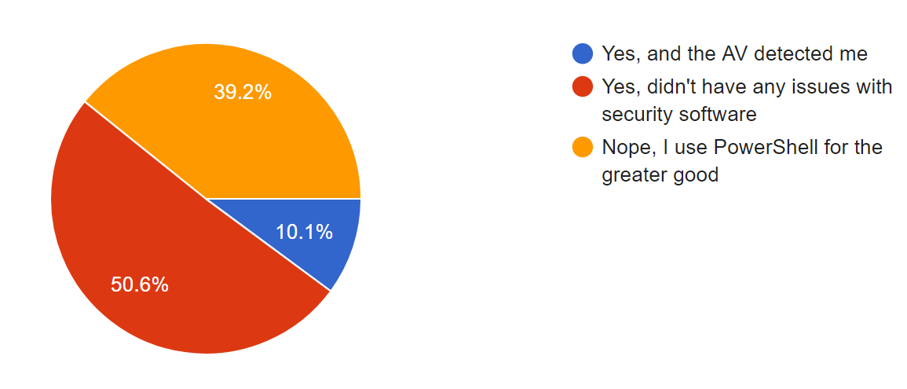
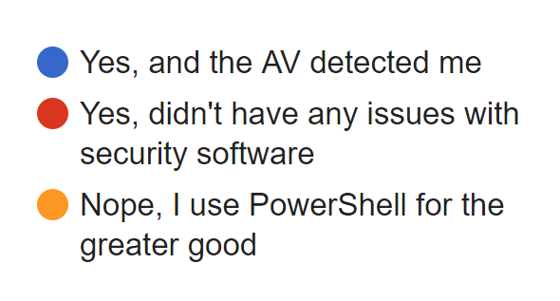
Have you ever used PowerShell to deploy malicious code?
Notes:
(for educational purposes, of course)

Slide 9
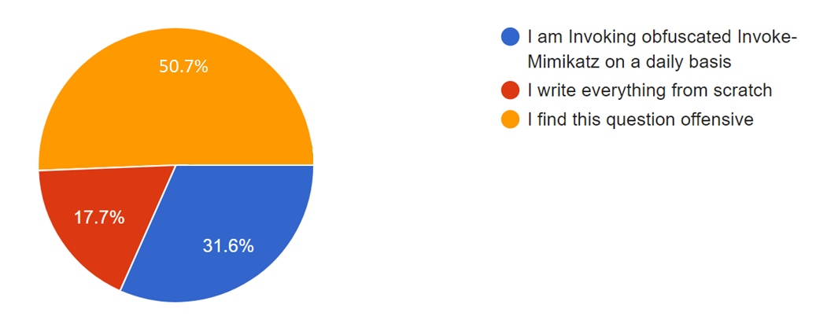
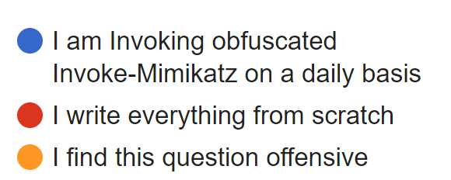
Have you ever used offensive PowerShell frameworks?

Slide 10
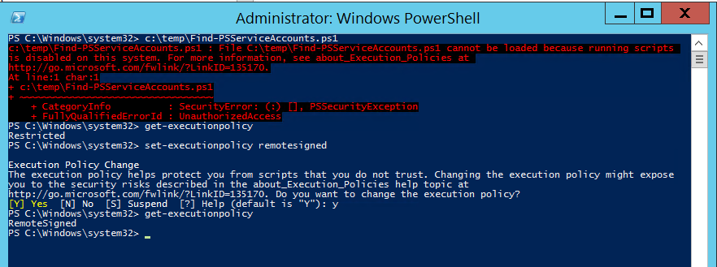
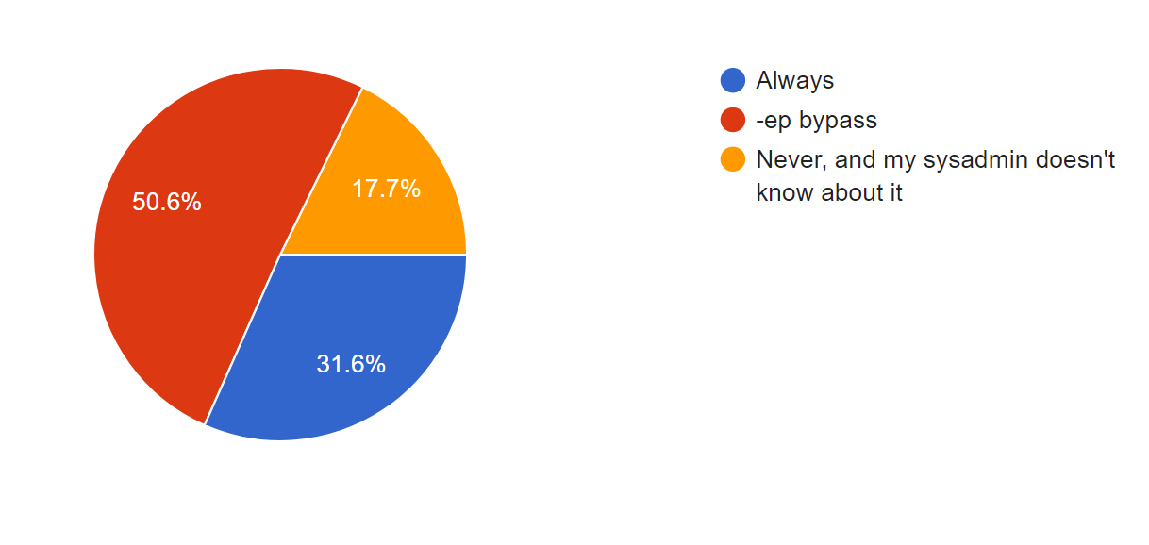
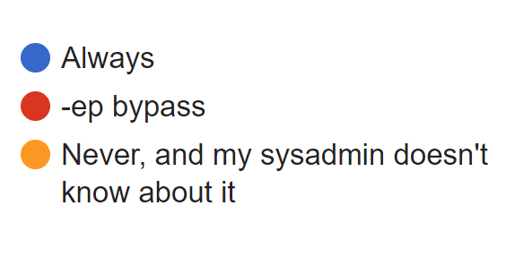
How often you encounter the "powershell execution is disabled on this system" message?

Slide 11
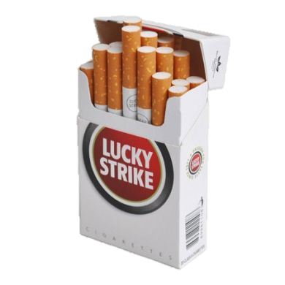
What do we miss?
Weaponizing
Overcoming restrictions
Understanding AV heuristics by trial and error
https://github.com/curi0usJack/luckystrike

Slide 12
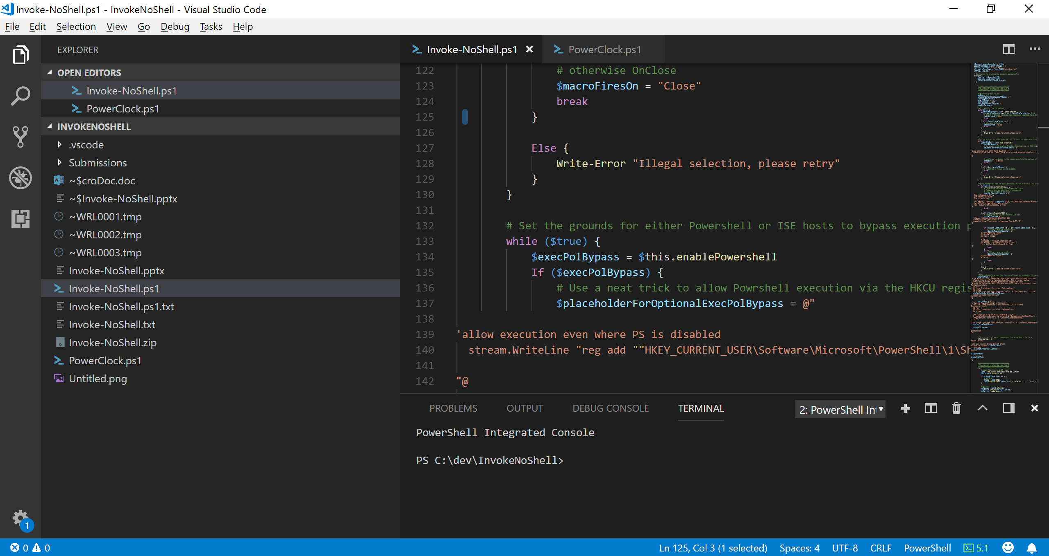
Invoke-NoShell
https://github.com/G4LB1T/Invoke-NoShell

Slide 13
Breaking Restrictions & ExecutionPolicy
Alternative script host
Pesky execution policy
Why not both? or just one?
When to trigger the payload?

Slide 14
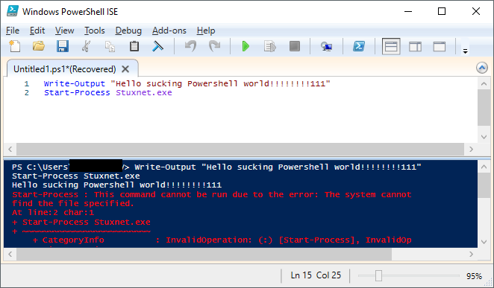

Slide 15
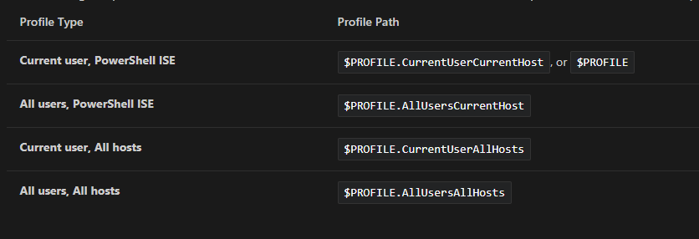

https://docs.microsoft.com/en-us/powershell/scripting/core-powershell/ise/how-to-use-profiles-in-windows-powershell-ise

Slide 16
But wait! You can’t -ep bypass!

Slide 17
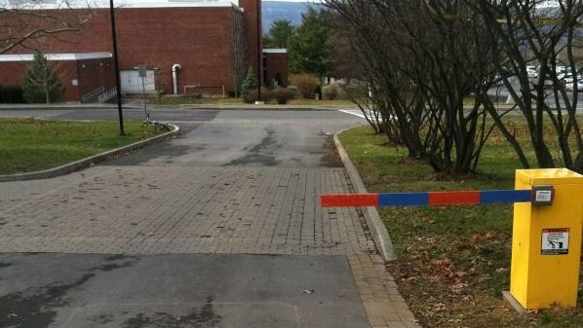
Execution Policy restriction does not work !!!

Slide 18
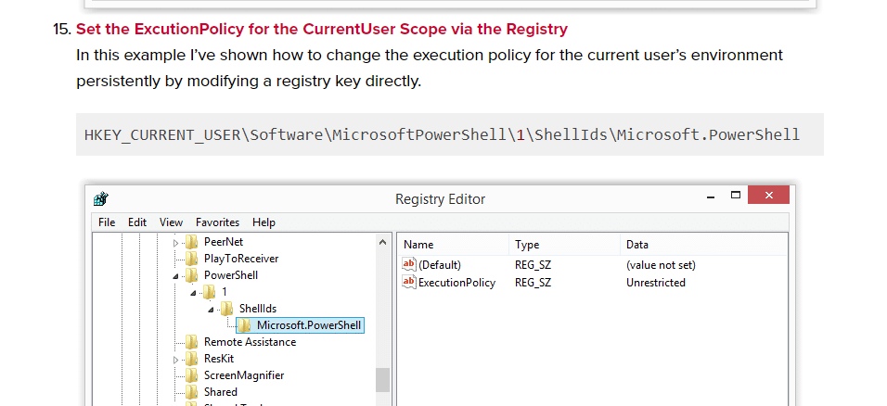
https://blog.netspi.com/15-ways-to-bypass-the-powershell-execution-policy/

Slide 19
How Does it work?
Using PowerShell to create more PowerShell ☺
Office COM object (you need to have Office ☹)
Permutations:
Launching on open/close/click
PowerShell ISE
Bypassing ExecutionPolicy

Slide 20
Manual mode
Select features
Document is ready!
Auto mode
Document is ready!
12 different permutations
Document is ready!
Document is ready!
Document is ready!
Document is ready!
Document is ready!

Slide 21

The Test

Slide 22
The Payload
Standard generic malware
Invoke-ReflectiveInjection
All local, no base64
12 documents

Slide 23
The Victim
Windows 10 x64
5 popular enterprise AV software (including “NG”)
Fully enabled

Slide 24
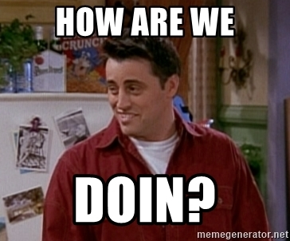
And the winner is…
Success criteria

Slide 25

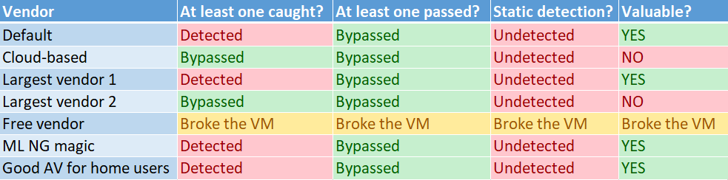

Slide 26
100%

Slide 27


Slide 28
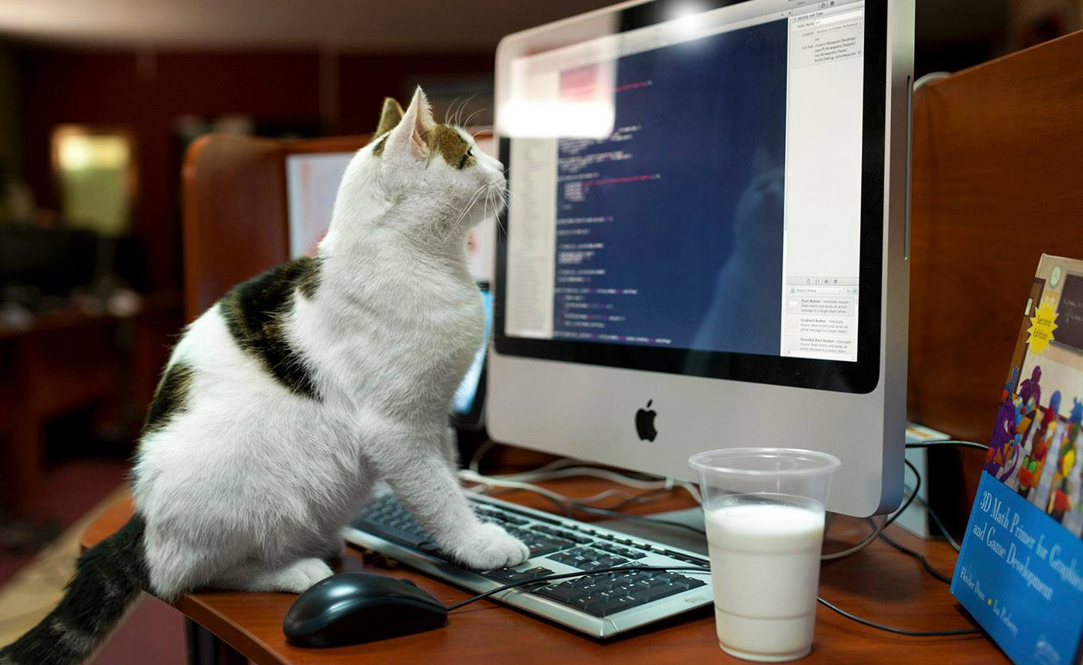
Q&A
@Gal_B1t
https://github.com/G4LB1T

